Slide 1

Understanding Total Rewards
Total rewards encompasses far more than just base compensation. It's a comprehensive approach that recognizes every element contributing to employee value—from competitive salaries and performance bonuses to benefits, career development opportunities, and workplace culture. Understanding this holistic framework is essential for building compensation strategies that truly resonate.

Slide 2

The Complete Rewards Spectrum
Beyond Base Pay
Total rewards integrates multiple components that work together to attract, motivate, and retain talent. Each element plays a distinct role in the employee value proposition.
Direct compensation and incentives
Health and wellness benefits
Career development and learning
Work-life balance and flexibility
Recognition and company culture

Slide 3


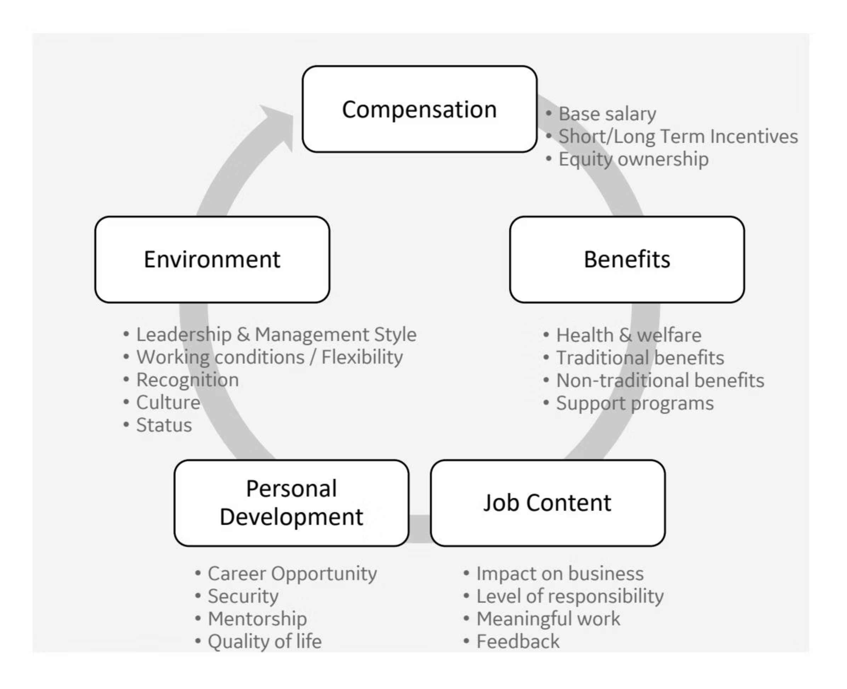
Value Perception Varies
All elements of total rewards matter, but their perceived value differs across individuals, career stages, and life circumstances. What motivates a recent graduate may differ significantly from what matters to a senior executive or working parent. A robust rewards philosophy recognizes this diversity and provides flexibility within a consistent framework.

Slide 4



Defining Our Rewards Philosophy
What It Is
A set of guiding principles that shape the development and strategy of compensation, benefits, and rewards programs—aligned with organizational values and culture.
Our Goal
To attract, retain, motivate, and reward employees who perform well and drive company success through globally consistent principles that remain locally relevant.

Slide 5








Four Pillars of Our Rewards Decisions
Market Competitive
Performance Based
Informed by relevant, job-related external market data that's externally benchmarked for local geographies and related industries.
Strong differentiation that rewards high performance, tied to both individual achievements and business outcomes.
Compliant & Equitable
Business Focused
Conforming to policy, governance principles, contractual agreements, and local regulations—based on job-related criteria, business conditions, and location.
Influenced by long-term business needs and shareholder impact, aligned with business financial planning and strategic objectives.

Slide 6

Market Pricing: The Foundation
The Principle
Every job must be assigned a market value to inform pay decisions. This ensures we remain competitive for top talent while avoiding two critical pitfalls:
Underpaying, leading to talent loss or recruitment challenges
Overpaying, wasting resources or preventing healthy turnover
Trusted Data Sources
We partner with reputable HR consulting firms who provide access to aggregated job data with statistically viable samples. These benchmarks represent both global and local industry and talent competitors. Self-reported data sites are not considered when establishing our pay ranges.

Slide 7
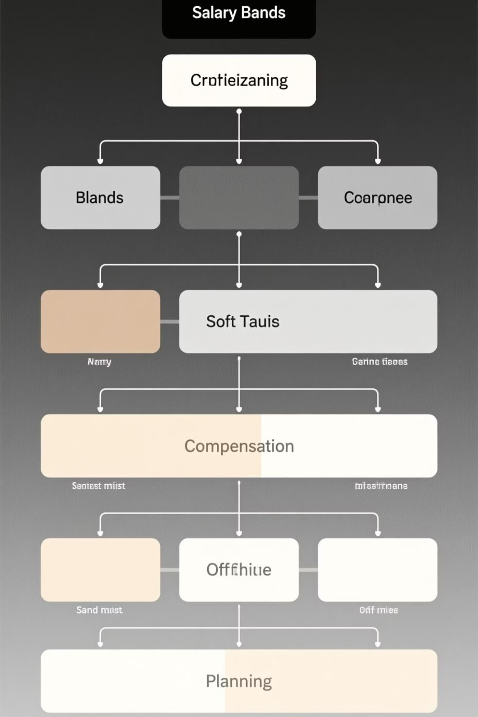



Pay Ranges: Structure and Purpose
What They Are
The upper and lower bounds of compensation—including minimum, midpoint, and maximum—determined by market data from external surveys for similar work in similar industries and regions.
Why We Need Them
They clarify market value, enable budget decisions, validate strategy, provide development discussion tools, ensure equity, and allow ease of administration.
Key Benefit
Pay ranges recognize the education, knowledge, skill, and experience needed for each role while quantifying compensation costs aligned to business goals.

Slide 8
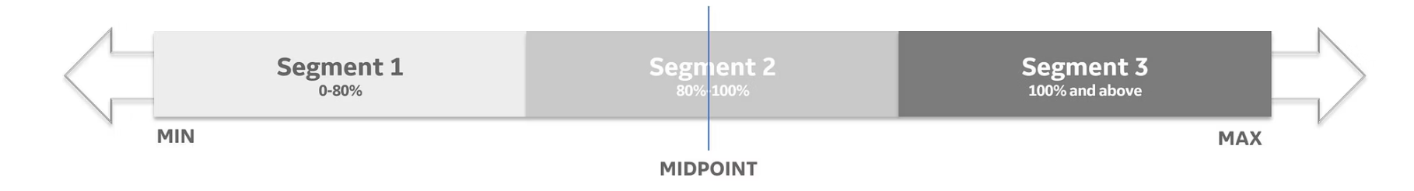


Understanding Compa Ratio
The Formula
What Is Compa Ratio?
A compa-ratio measures the relationship between an employee's salary and the midpoint of their pay range. It's a critical metric for assessing pay positioning and ensuring internal equity.
This calculation provides a standardized way to compare compensation across different roles and levels within the organization.

Slide 9

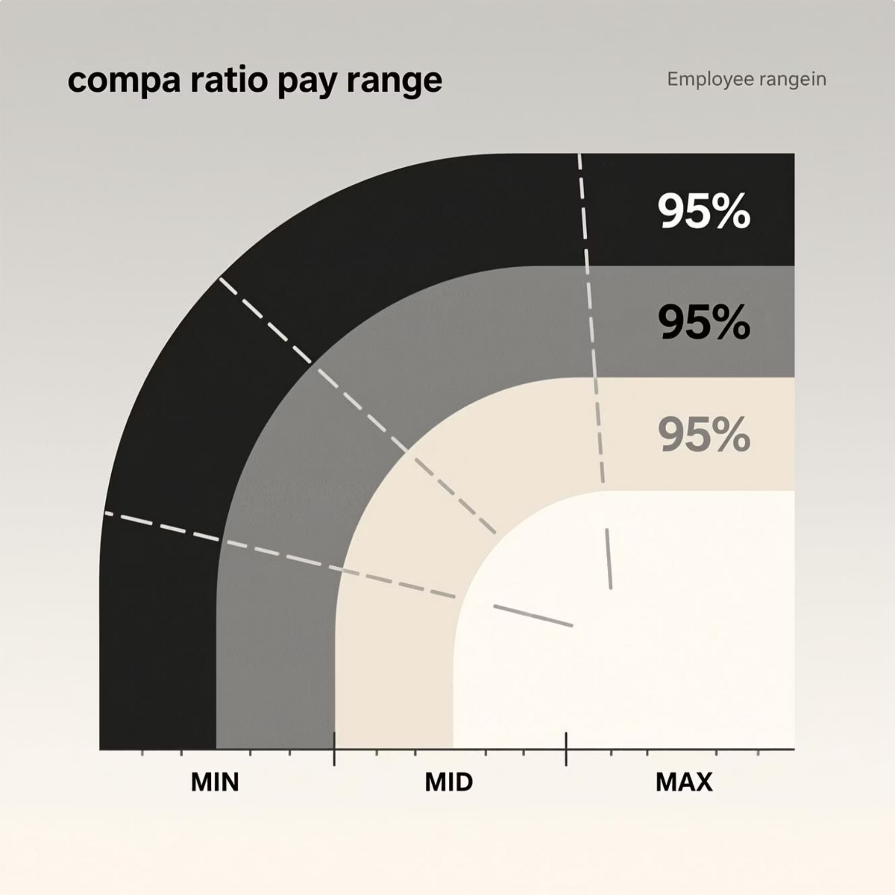
Calculating Compa Ratio: A Practical Example
01
Identify Base Salary
Employee's current base salary: $95,000
02
Determine Range Midpoint
Pay range midpoint for the position: $100,000
03
Apply the Formula
Compa Ratio = $95,000 ÷ $100,000
04
Calculate Result
Compa Ratio = 0.95 or 95%
This 95% compa ratio indicates the employee is positioned slightly below the market midpoint, suggesting room for growth within the range based on performance, experience, and skill development.

Slide 10

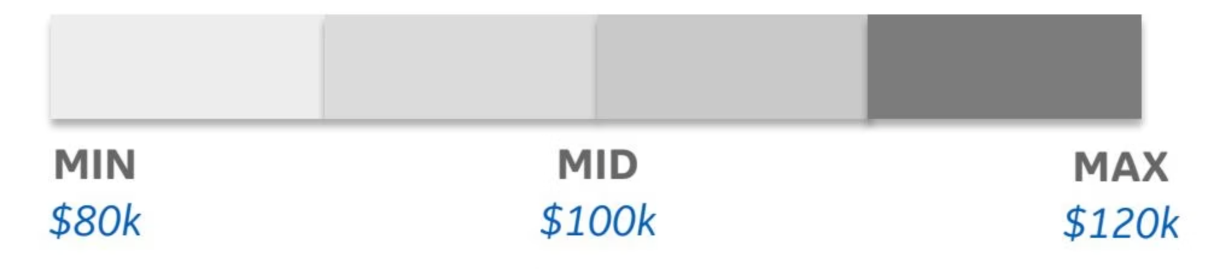
Pay Ranges Enable Internal Calibration
Strategic Positioning
Key Takeaways
External benchmark data drives range creation
Pay ranges provide flexibility to account for job-related skills, expertise, and experience while maintaining market competitiveness and internal equity across the organization.
Ranges allow variation within accepted bounds
Compa ratios enable consistent calibration
Framework supports both attraction and retention

